Slide 1
Investigation of Asian Options
Benjamin Alioni, Cory Peters, Sidney Washburn

Slide 2
What are Asian Options?
Asian Options are a type of exotic option whose payoff is determined by the average price of the underlying stock.
A = Average stock price from initiation to expiration.
K = Strike Price.
Asian Call: Payoff = max(A - K, 0)
Asian Put: Payoff = max(K - A, 0)

Slide 3
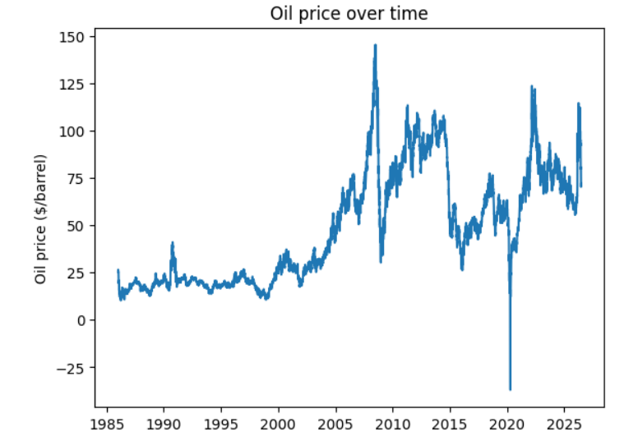
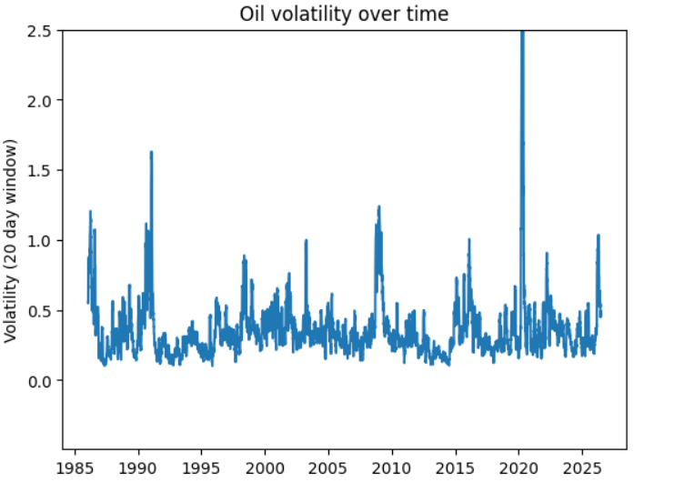
Why use Asian Options?
The averaging reduces the effect of volatility. This can be beneficial for assets which can experience volatility spikes, such as crude oil or other commodities.

Slide 4
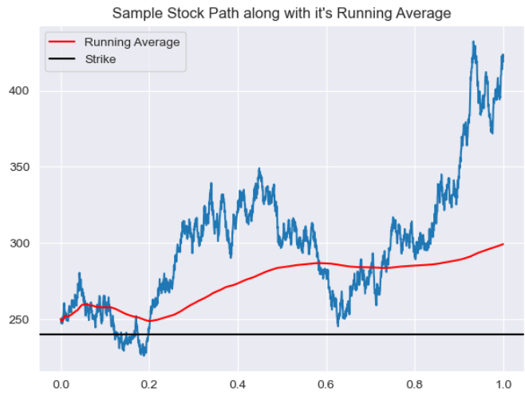
Example: The Payoff Asian Call
An Asian Call on this stock would pay out about $60.
A European call would pay out roughly $125.

Slide 5
Pricing Asian Calls
In the pricing European options, the framework of Black–Scholes provides an explicit, closed-form formula. There is also the computationally efficient binomial tree model for pricing American options.
The situation for Asian options is more delicate. There is no such explicit formula, but one can still estimate the value. The binomial tree model no longer works because of the path-dependence of Asian options. Two possible methods are Monte Carlo approximation and estimation via a PDE.

Slide 6
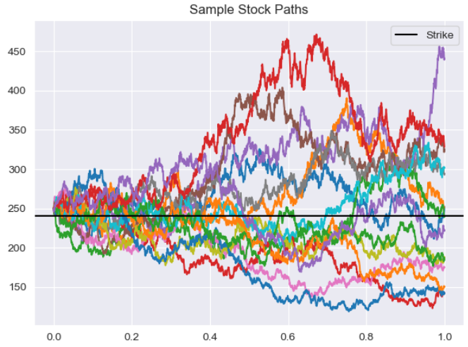
Pricing via Monte Carlo
The simplest surefire way to estimate the value of an Asian option is to simulate many stock paths, calculate the payout of the option corresponding to each path, then compute the average payout among all the simulated paths.
Average Payout =
Payouts / Number of Simulations
= $96.88

Slide 7
Pricing via Monte Carlo (cont.)
Unlike European options, the payout of an Asian option depends upon the entire stock path. This makes simulation and calculation of a payout much slower when compared to an analogous calculation for European options.
1-year Asian call with:
Strike = $240
Initial Stock Price = $250
Stock Volatility = 0.4
Risk-free Interest Rate = 3.5%
Monte Carlo estimate of average Asian payout with 10000 simulated stock paths:
$29.47,
with standard error:
0.4298,
and runtime: 1.011 seconds.

Slide 8
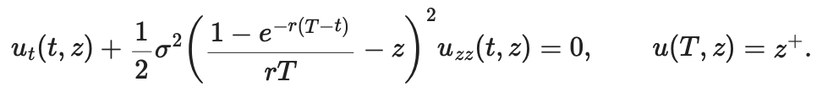

Pricing via the Večeř PDE
The Večeř method rewrites the pricing problem using a transformed variable Z(t), which reduces the original path-dependent problem to a one-dimensional PDE:
We can then recover the payoff at maturity T of a fixed-strike Asian call option as
This PDE does not have a simple closed-form solution, so it is solved using numerical methods, such as finite-difference schemes.

Slide 9
Pricing via the Večeř PDE (cont.)
Our results were within the 95% confidence interval obtained from the Monte Carlo simulation, and ran in about a third the time.
1-year Asian call with:
Strike = $240
Initial Stock Price = $250
Stock Volatility = 0.4
Risk-free Interest Rate = 3.5%
Večeř PDE estimate of average Asian payout:
$29.55,
and runtime: 0.368 seconds.

Slide 10
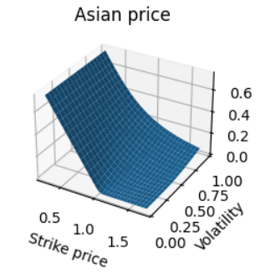
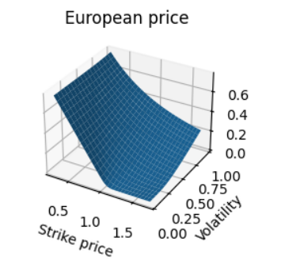
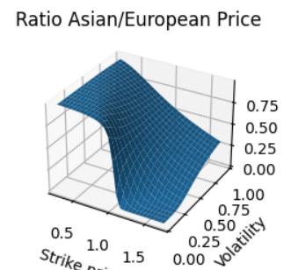
Comparing Prices
The Monte Carlo method and the Večeř PDE gave us identical results, which gives us confidence we implemented both correctly
As one might expect, Asian calls have smaller premiums than European calls.
(All starting prices are 1 in the above figures)

Slide 11
Calculation of Δ
The Δ of an option (at time t) is the rate at which the value of the option changes as the underlying stock price changes, i.e. the following partial derivative:
Δ = ∂V/∂S_t,
where V is the value of the of the option and S_t is the underlying stock price at time t.
Δ = ∂V/∂S_t,

Slide 12

Calculation of Δ (cont.)
Simplest and direct approach: Estimate the difference quotient
Using Monte Carlo methods to estimate the terms in the numerator gives an estimate, but the estimate is inconsistent and gives nonsensical answers due to the inherent error of estimating the terms in the numerator.

Slide 13


Calculation of Δ (cont.)
Better approach: Pathwise estimation.
Let A be the average stock price at expiration. The precise definition of Δ is the following expression:
It can be shown that the derivative and the expectation may be interchanged. So to estimate Δ, one may estimate the expected value of

Slide 14

Calculation of Δ (cont.)
Under the assumption that the stock follows Geometric Brownian Motion, we can explicitly calculate the derivative in terms of the underlying stock prices:
The estimation of Δ by this method is much cleaner and gives decent results under Monte Carlo methods. An example calculation:
Sigma = 0.4
r = 0.04
Initial Stock Price = $1
K = $1
Time to Expiration = 1
Estimate of Δ:
0.53
With standard error:
0.005

Slide 15
Comparing Delta
For sigma = 0.4, r = 0.03, T = 1, and S_0 = 1, we got the following values for delta for call options
 | European | Asian (95% CI)
K= 0.8 | 0.805 | (0.820, 0.840)
K = 0.9 | 0.713 | (0.691, 0.711)
K = 1.0 | 0.618 | (0.525, 0.548)
K = 1.1 | 0.525 | (0.386, 0.409)
K = 1.2 | 0.438 | (0.255, 0.276)

Slide 16
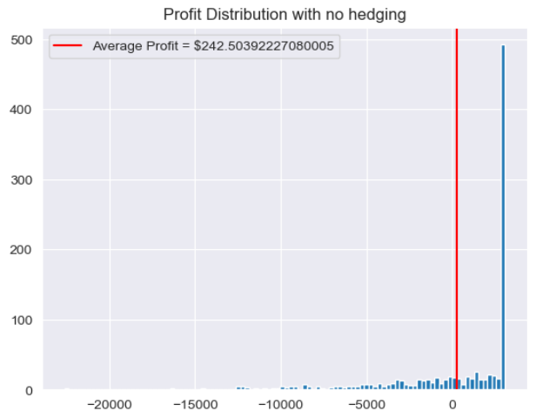
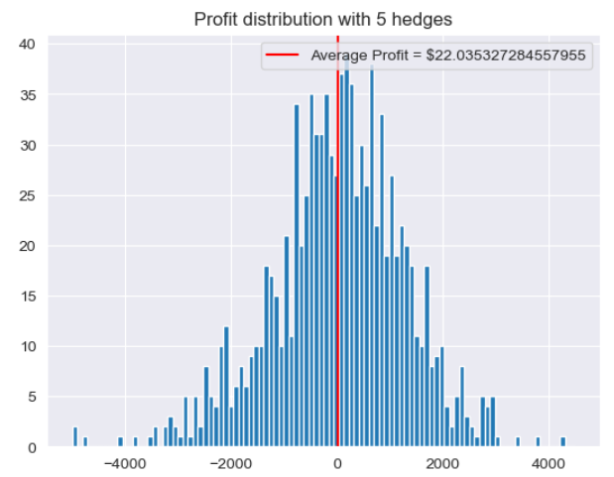
Delta Hedging
Using the estimated Δ’s, we simulated the profits of selling a portfolio consisting of 100 Asian calls, sold $60 above the expected payout. The results are similar to the vanilla case.

Slide 17
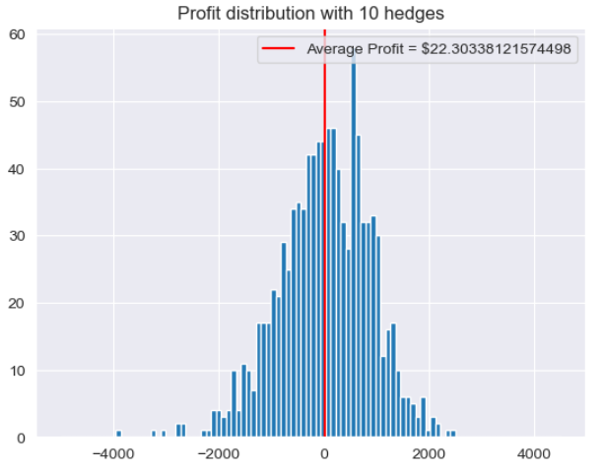
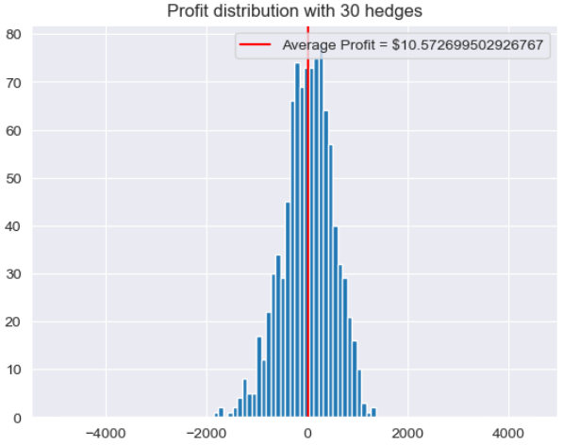
Delta Hedging (cont.)

Slide 18
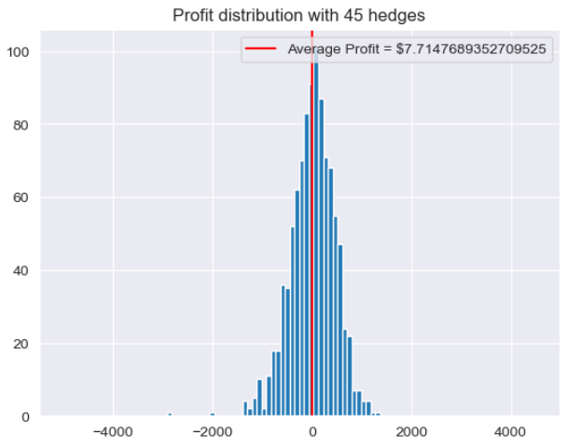
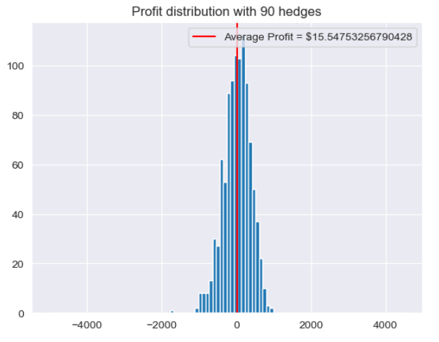
Delta Hedging (cont.)

Slide 19
References
Stochastic Calculus for Finance II, Steven E. Shreve. (2004)
"Estimating the Greeks", Lecture notes by Martin Haugh. Link: https://www.columbia.edu/~mh2078/MonteCarlo/MCS_Greeks.pdf

